Slide 1


Relational Work and Identity Construction in
Email Counseling

Slide 2
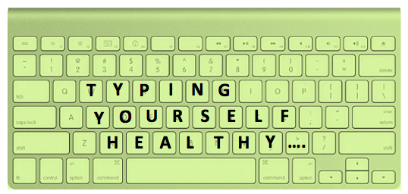



SNF-Project “Language and Health Online”
http://language-health-online.unibas.ch
- Persuasion in Smoking Cessation Online
- Relational Work in Email Counseling
Notes:
Bild von Website

Slide 3
1. Introduction
Interpersonal Pragmatics
Relational Work
Identity Construction
Computer-mediated Communication
Written
Health Discourse
Email Counseling
Asynchronous
Private
One-one

Slide 4
2. Background
Investigating how the relationship between the client and the therapist is established and maintained through the use of written language in emails.
Identity Construction
Relational work

Slide 5
3. Research Questions
What are the medium characteristics of email counseling?
(e.g. header, copy-paste function)
What activities (discursive moves) can be found in the practice?
(e.g. problem statement, greeting, request for information)
What kind of relational work is used?
(e.g. bonding, empathizing)
How are the participants constructing their identities?
What strategies concerning relational work and identity construction seem to enhance the relationship?

Slide 6
4. Data / Methodology
Discourse Analysis => close, qualitative reading of texts to find structural patterns of language use
Counseling Service of British university
Informed retrospective consent
Exchanges anonymized by counselors
Email exchanges between clients and counselors (usually 6-8 emails)
Issues of anxiety, depression, family troubles, etc
Exchange of strategies to overcome / deal with these issues

Slide 7
5. Identity Construction in the Therapeutic Alliance
    Krupnick et al. (1996: 532) define the therapeutic alliance as: “the collaborative bond between therapist and patient”
    Functions as a tool to induce change in the client’s life

Slide 8
5. Identity Construction in the Therapeutic Alliance
Example 1 Therapist Email 1
“Welcome to E-counseling, where we can exchange several back-and-forth letters, in this confidential shared space.”
Example 2 Therapist Email 1
“Together, we will look for the path ahead and the life you can make whole again.”
  Example 3 Therapist Email 2
  “In our remaining exchanges, I would like to hear about your own ways of accessing that.”

Slide 9
6. Conclusion / Aims
  Identity construction
  Relational work
  Link between identity construction and relational work
  Applied: descriptive framework of strategy patterns that seem to enhance the therapeutic alliance

Slide 10
7. Selected References
Bucholtz, M. and K. Hall (2005). “Identity and interaction: A sociocultural linguistic approach.” Discourse Studies 7(4-5): 585-614.
Locher, M.A. (2006). Advice Online. Advice-giving in an American Internet Health Column. Amsterdam, John Benjamins.
Locher, M.A. and S. L. Graham, Eds. (2010). Interpersonal Pragmatics. Handbooks of Pragmatics. Berlin, Mouton.
Krupnick, J. L., et al. (1996). “The role of the therapeutic alliance in psychotherapy and pharmacotherapy outcome. Findings in the National Institute of Mental Health Treatment of Depression Collaborative Research Program.” Journal of Consulting and Clinical Psychology 64(3): 532-539.
Richardson, K. P. (2005). Internet Discourse and Health Debates. New York, Palgrave, Macmillan.
Schulz, P. J. and S. Rubinelli (2010). “Internet-enhanced health communication.” Social Semiotics 20(1): 3-7.

